Slide 1
HTML + CSS Session 3
Basant Mohamed

Slide 2

Pseudo Class
A pseudo-class is used to define a special state of an element.
For example, it can be used to:
Style an element when a user mouses over it
Style visited and unvisited links differently
Style an element when it gets focus
Ex: a: hovar , a:visited , a:link , a:active

Slide 3

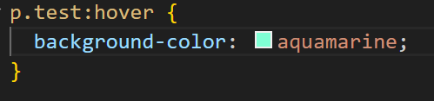
pseudo class with HTML class
Pseudo-classes can be combined with HTML classes

Slide 4
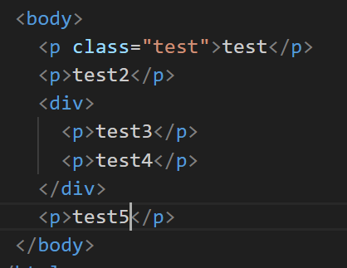
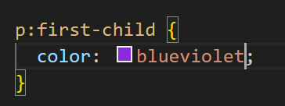
First child pseudo class
The :first-child pseudo-class matches a specified element that is the first child of another element.

Slide 5
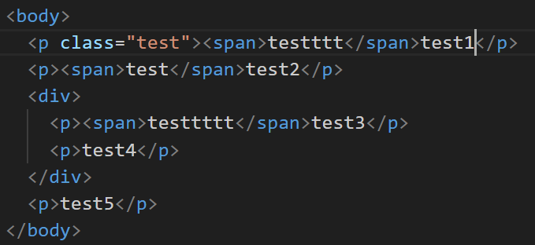
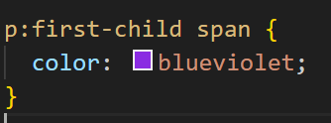
First child pseudo class
More >> https://developer.mozilla.org/en-US/docs/Web/CSS/Pseudo-classes

Slide 6
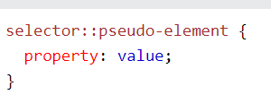
Pseudo elements
A CSS pseudo-element is used to style specified parts of an element.
For example, it can be used to:
Style the first letter, or line, of an element
Insert content before, or after, the content of an element

Slide 7
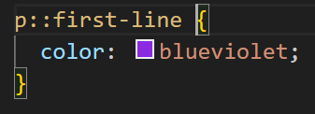
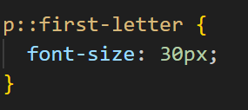
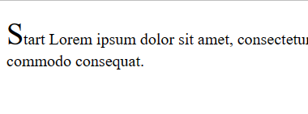
::first-line pseudo elements
::first-letter pseudo elements
The ::first-line pseudo-element is used to add a special style to the first line of a text.
The ::first-letter pseudo-element is used to add a special style to the first letter of a text

Slide 8
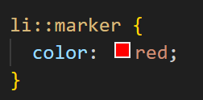
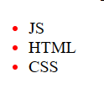

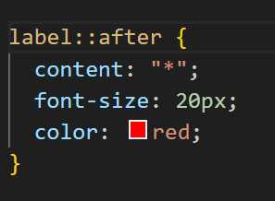

::marker pseudo elements
::after pseudo elements
More >> https://developer.mozilla.org/en-US/docs/Web/CSS/Pseudo-elements

Slide 9

Any Question ????

Slide 10
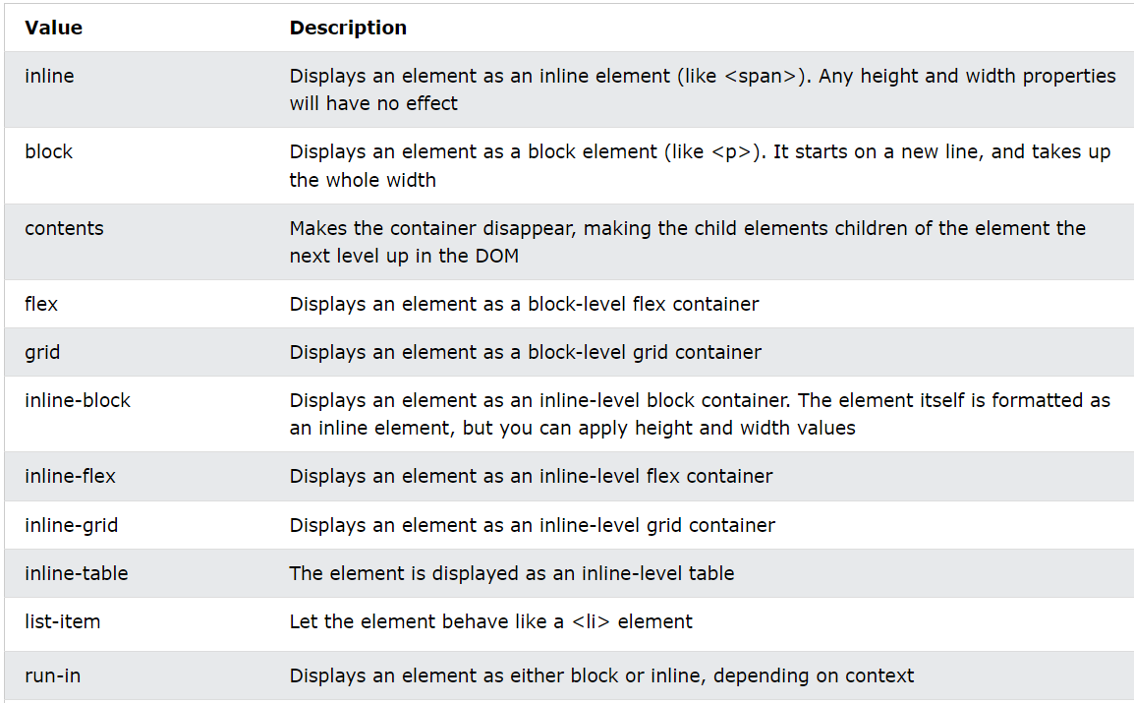
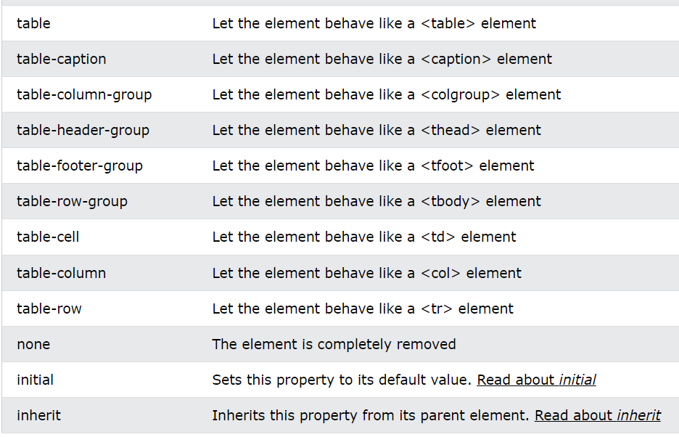
Display
The display property specifies the display behavior (the type of rendering box) of an element

Slide 11
Position
The position property specifies the type of positioning method used for an element.
There are five different position values:
Static : HTML elements are positioned static by default.Static positioned elements are not affected by the top, bottom, left, and right properties.
Relative : is positioned relative to its normal position , will cause it to be adjusted away from its normal position. Other content will not be adjusted to fit into any gap left by the element.
Fixed : is positioned relative to the viewport, which means it always stays in the same place even if the page is scrolled. The top, right, bottom, and left properties are used to position the element.
Absolute : is positioned relative to the nearest positioned ancestor , However; if an absolute positioned element has no positioned ancestors, it uses the document body, and moves along with page scrolling.
Sticky : is positioned based on the user's scroll position.A sticky element toggles between relative and fixed, depending on the scroll position. It is positioned relative until a given offset position is met in the viewport - then it "sticks" in place (like position:fixed).

Slide 12
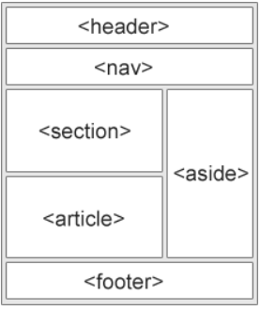
HTML Layout
HTML has several semantic elements that define the different parts of a web page:
<header> - Defines a header for a document or a section
<nav> - Defines a set of navigation links
<section> - Defines a section in a document
<article> - Defines an independent, self-contained content
<aside> - Defines content aside from the content (like a sidebar)
<footer> - Defines a footer for a document or a section
<details> - Defines additional details that the user can open and close on demand
<summary> - Defines a heading for the <details> element

Slide 13
HTML Layout Techniques
There are four different techniques to create multicolumn layouts. Each technique has its pros and cons:
CSS framework : Bootstrap.
CSS float property
CSS flexbox
CSS grid

Slide 14
CSS float Property
The CSS float property specifies how an element should float.
left - The element floats to the left of its container
right - The element floats to the right of its container
none - The element does not float (will be displayed just where it occurs in the text). This is default
inherit - The element inherits the float value of its parent

Slide 15
CSS clear Property
When we use the float property, and we want the next element below (not on right or left), we will have to use the clear property.
The clear property specifies what should happen with the element that is next to a floating element.
The clear property can have one of the following values:
none - The element is not pushed below left or right floated elements. This is default
left - The element is pushed below left floated elements
right - The element is pushed below right floated elements
both - The element is pushed below both left and right floated elements
inherit - The element inherits the clear value from its parent

Slide 16
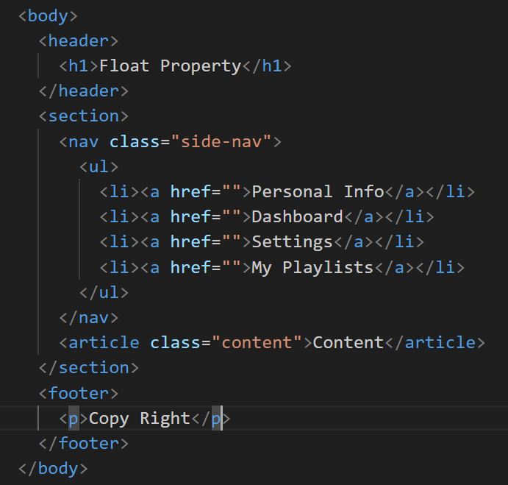
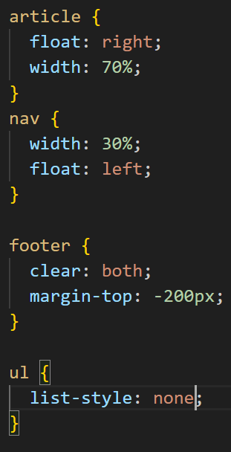
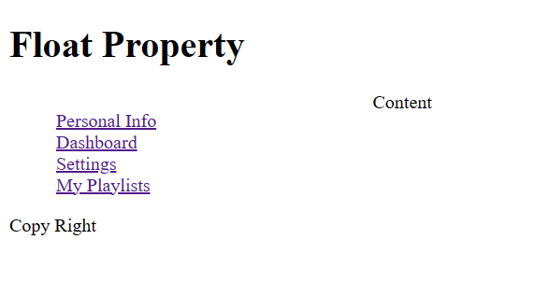

Slide 17
Flexbox layout
Before the Flexbox Layout module, there were four layout modes:
Block, for sections in a webpage
Inline, for text
Table, for two-dimensional table data
Positioned, for explicit position of an element
The Flexible Box Layout Module, makes it easier to design flexible responsive layout structure without using float or positioning.

Slide 18
Flex Container
The flex-direction property defines in which direction the container wants to stack the flex items.
Values :
The column value stacks the flex items vertically (from top to bottom)
The column-reverse value stacks the flex items vertically (but from bottom to top)
The row value stacks the flex items horizontally (from left to right)
The row-reverse value stacks the flex items horizontally (but from right to left)

Slide 19
Flex Container
The flex-wrap property specifies whether the flex items should wrap or not
Values :
The wrap value specifies that the flex items will wrap if necessary
The nowrap value specifies that the flex items will not wrap (this is default)
The wrap-reverse value specifies that the flexible items will wrap if necessary, in reverse order
The flex-flow property is a shorthand property for setting both the flex-direction and flex-wrap properties.
The justify-content property is used to align the flex items , values (center , end , start , space-between , space around ,..)

Slide 20
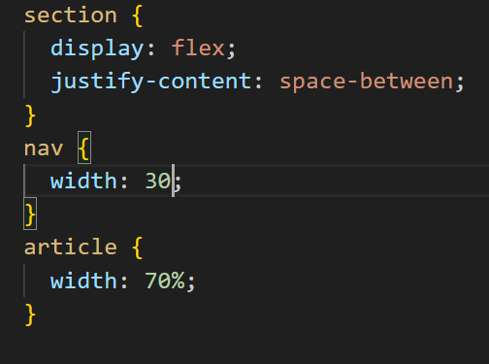

Slide 21
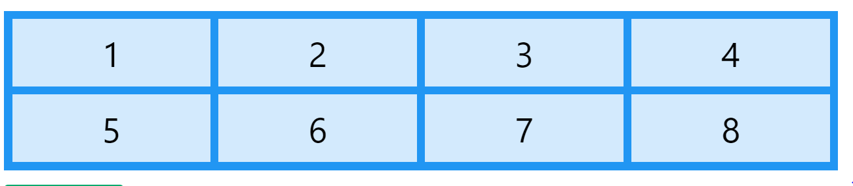
CSS Grid layout
The CSS Grid Layout Module offers a grid-based layout system, with rows and columns, making it easier to design web pages without having to use floats and positioning.

Slide 22
Grid Container
To make an HTML element behave as a grid container, you have to set the display property to grid or inline-grid.
Grid containers consist of grid items, placed inside columns and rows.
The grid-template-columns property defines the number of columns in your grid layout,
The grid-template-rows property defines the height of each row
The justify-content property is used to align the whole grid inside the container
The align-content property is used to vertically align the whole grid inside the container
The gap property is width of gap between columns

Slide 23
Grid Item
A grid container contains grid items.
By default, a container has one grid item for each column, in each row, but you can style the grid items so that they will span multiple columns and/or rows.
The grid-column property defines on which column(s) to place an item( it short of grid-column-start and the grid-column-end ) To place an item, you can refer to line numbers, or use the keyword "span" to define how many columns the item will span.
The grid-row property defines on which row to place an item
More Info : repeat() - CSS: Cascading Style Sheets | MDN (mozilla.org)

Slide 24
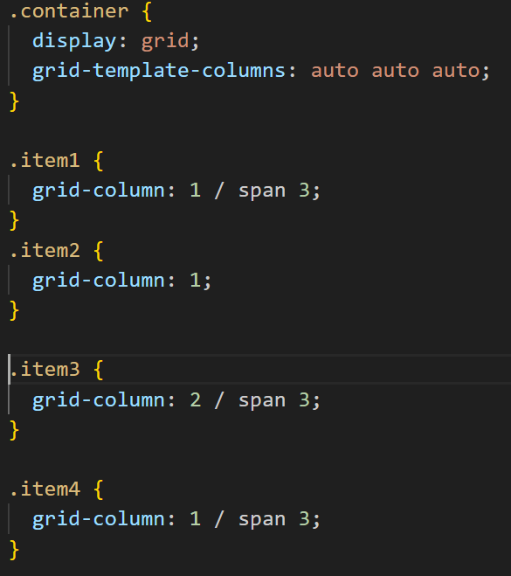
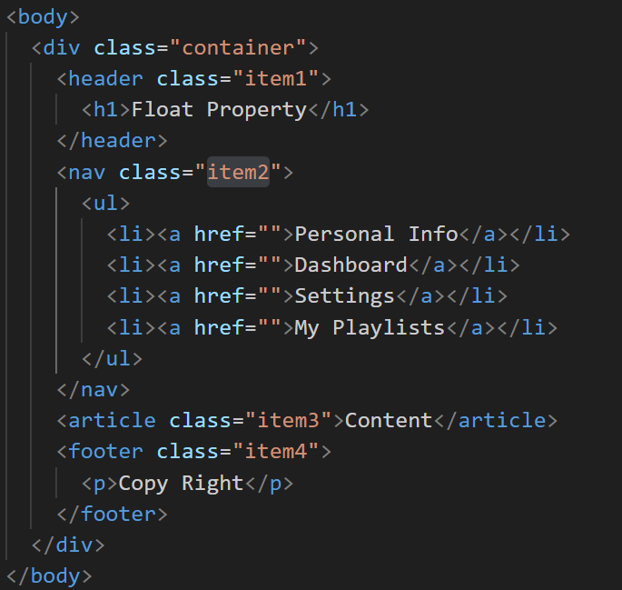

Slide 25
Icon
The simplest way to add an icon to your HTML page, is with an icon library, such as Font Awesome.
Add the name of the specified icon class to any inline HTML element (like <i> or <span>).
Add font Awesome on head tag : <link href="//netdna.bootstrapcdn.com/font-awesome/3.2.1/css/font-awesome.css" rel="stylesheet" />
OR Add font Awesome on head tag :
<link rel="stylesheet" href="https://cdnjs.cloudflare.com/ajax/libs/font-awesome/6.4.0/css/all.min.css" integrity="sha512-iecdLmaskl7CVkqkXNQ/ZH/XLlvWZOJyj7Yy7tcenmpD1ypASozpmT/E0iPtmFIB46ZmdtAc9eNBvH0H/ZpiBw==" crossorigin="anonymous" referrerpolicy="no-referrer" />
Documentation : https://fontawesome.com/v4/examples/

Slide 26
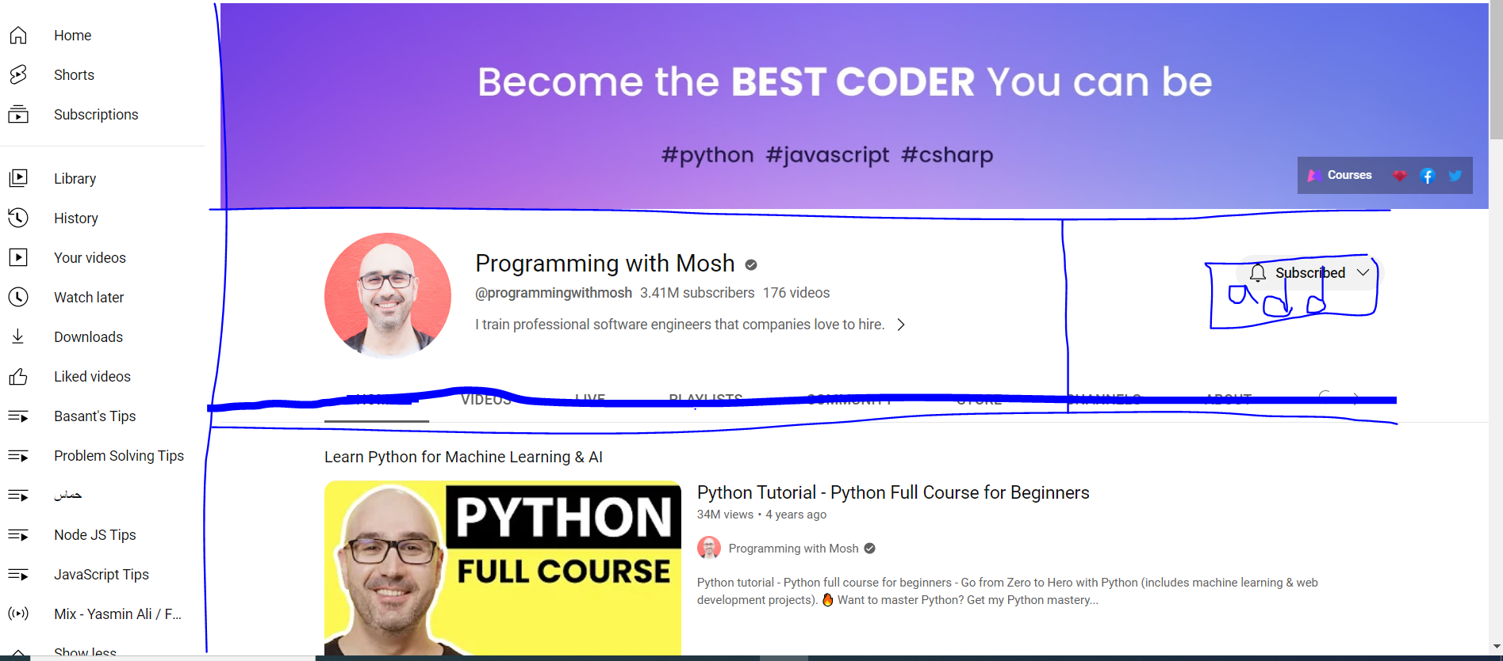
Task

